Slide 1
… Lecture 5 … Shrinkage

Slide 2
… Lecture 5 … Shrinkage
Part 1: uncovering the truth behind random effects!

Slide 3
Fixed or Random
What is a fixed effect?
What is a random effect?

Slide 4
Fixed or Random
What is a fixed effect?
What is a random effect?
Why does it matter?
What is the difference?

Slide 5
Random Effects
Randomly drawn from a distribution with a finite variance
typically Multi-Variate Normal … MVN
but doesn’t have to be!
a form of prior knowledge that can be used
e.g. in BLUP, REML

Slide 6
Fixed Effects
Randomly drawn form a distribution with a finite variance
typically MVN
but doesn’t have to be!
a form of prior knowledge that can be used
e.g. BLUP, REML
Fixed effects
not Random!

Slide 7
Examples of Fixed Effects
Systematic, repeatable across experiments
e.g. sex, drug, birth type
effects of temperature, or light
top two sires and bottom two sires
“almost all levels of factor contained in the data”

Slide 9
So What?
Imagines some sire families
each with n offspring … e.g. n=5 here

Slide 10
So What?
Record offspring, variance Ve within families
fit ‘sire’ as fixed effect to get the ‘LS’ means
LS – is Least Squares … outcomes of fixed effect models
variance of each sire mean estimate = Ve/n

Slide 11
So What?
Record offspring, variance Ve within families
variance of each sire mean estimate = Ve/n
now assume sires random, with variance Vs
Vs

Slide 12
So What?
Record offspring, variance Ve within families
variance of each sire mean estimate = Ve/n
now assume sires random, with variance Vs
total variance of sire mean estimates = Vs + Ve/n

Slide 13
So What?
Record offspring, variance Ve within families
variance of each sire family mean = Ve/n
now assume sires random, with variance Vs
total variance of sire mean estimates = Vs + Ve/n
Total Variance = Variance ‘within’ + Variance ‘between’

Slide 14
Problem (1)
We are overestimating the scale of the variation by the sire family means!
cannot be unbiased
top overestimated, bottom underestimated
True values with Vs
LS values with Vs+Ve/n

Slide 15
Problem (2)
What if we select …
LS values with Vs+Ve/n_{large}
LS values with Vs+Ve/n_{small}

Slide 16
Problem (3)
What must be expected to happen to selected individual with more information …

Slide 17
Problem (3)
What must be expected to happen to selected individual with more information …

Slide 18
What Can be Done?
Shrink the ‘LS’ estimates …

Slide 19
What Can be Done?
Shrink the ‘LS’ estimates …
regress them back to the population mean …

Slide 20
What Can be Done?
Shrink the estimates …
regress them back to the population mean …
but how much?

Slide 21
What Can be Done?
Shrink the ‘LS’ estimates …
regress them back to the population mean …
regression coefficient, b ~ f(info)/[1+f(info)] < 1
where f(info) is a measure of information ( ≥ 0)
more info, b → 1, as estimate has smaller error
… this emerges from theory

Slide 22
Random Effects
If an effect is declared as random the ideas of shrinkage are directly incorporated into the estimation process & the estimates obtained!
In QGM
we do not need to know how it is estimated
we do need to know
this idea differentiates fixed LS and random estimates
the extent of shrinkage is a function of information

Slide 24
Shrinkage
For REML & our sires, f(info) = n(Vs/Ve)
more offspring (n ↑), so f(info) ↑, so b ↑
more data points!

Slide 25
Shrinkage
For REML & our sires, f(info) = n(Vs/Ve)
more offspring (n ↑), so f(info) ↑, so b ↑
more data points!
Vs/Ve ↑, so f(info) ↑, so b↑
each record richer in sire information
less influenced by random error
Vs/Ve ↑ means h² ↑
analogous to ‘signal to noise’ ratio

Slide 26
Shrinkage
For REML & our sires, f(info) = n(Vs/Ve)
more offspring (n ↑), so f(info) ↑, so b ↑
more data points!
Vs/Ve ↑, so f(info) ↑, so b↑
each record richer in sire information
less influenced by random error independent of the sire
Vs/Ve ↑ means h² ↑
analogous to ‘signal to noise’ ratio
See the notes which shows a heuristic derivation of f(info) by linear regression!

Slide 27
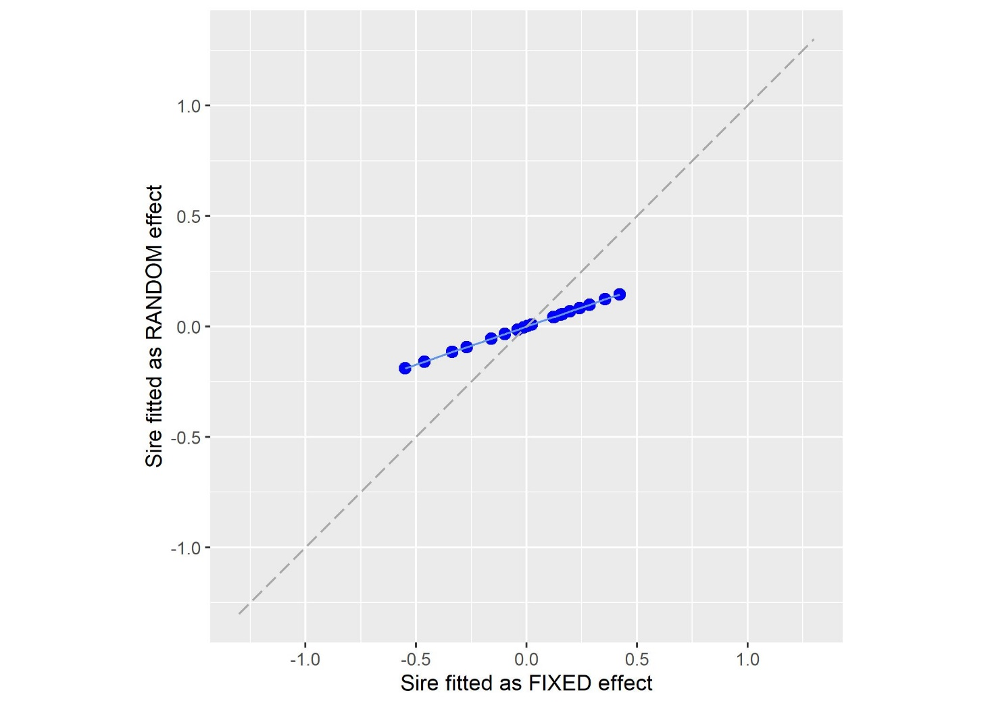
Example
Fit ‘sire’ as fixed & fit ‘sire’ as random

Slide 28
Low Signal to Noise Ratio
20 unrelated sires, 10 offspring, Vs/Ve = 0.05
Slope = 0.34

Slide 29
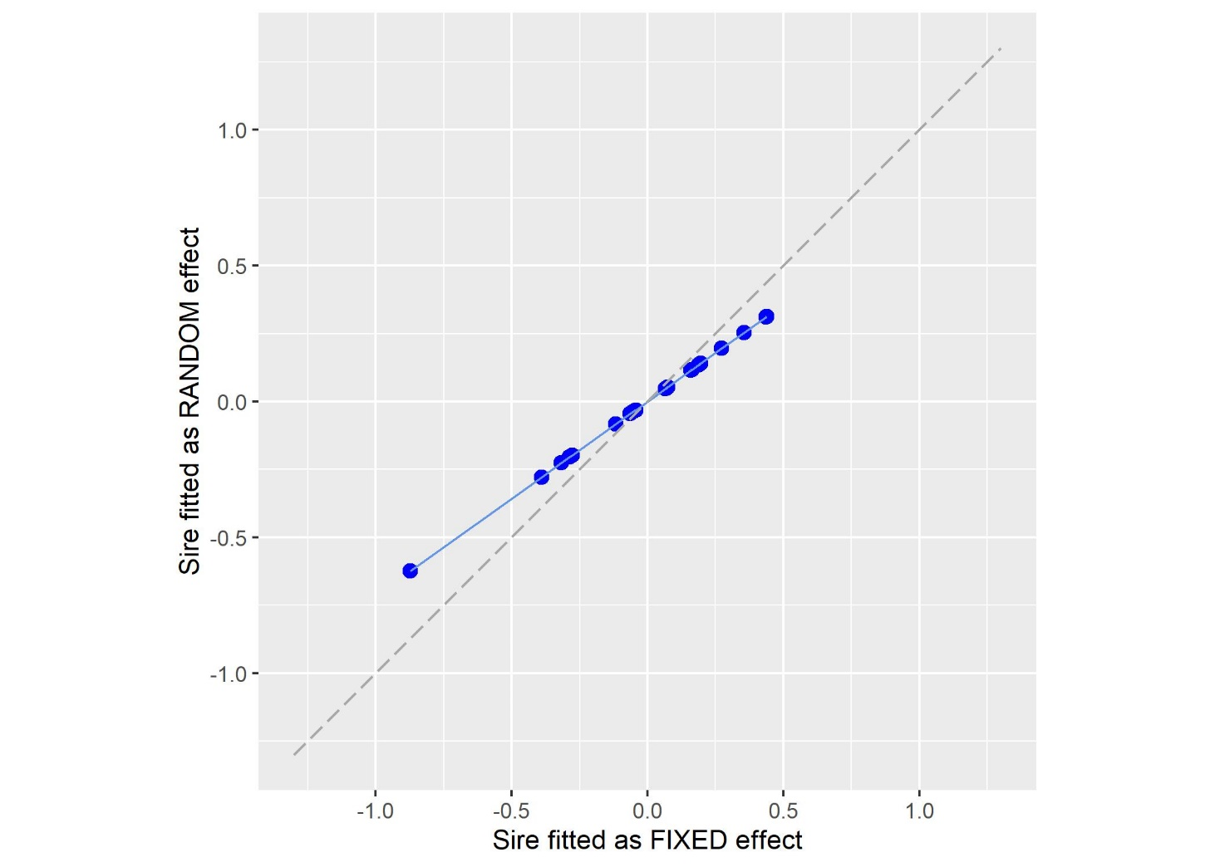
Increased Signal …
20 unrelated sires, 10 offspring, Vs/Ve = 0.20
Slope = 0.71
Each record richer in genetic information
less shrinkage
slope increases

Slide 30
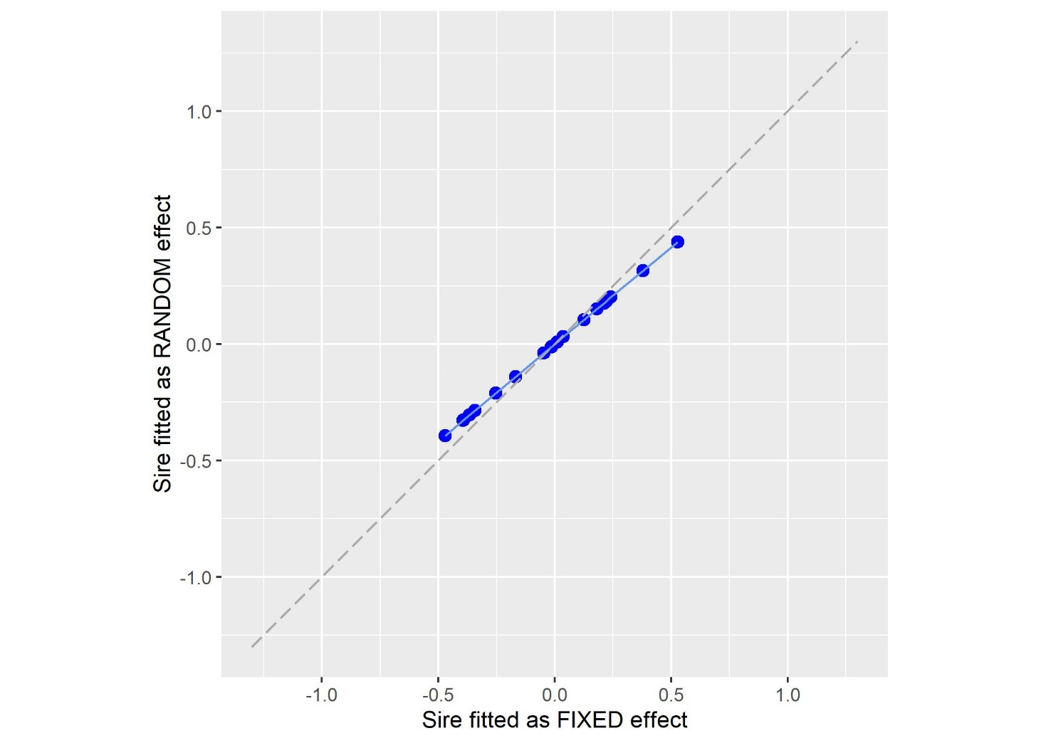
More Records …
20 unrelated sires, 20 offspring, Vs/Ve = 0.20
Slope = 0.83
More records, more information
less shrinkage
slope increases

Slide 31
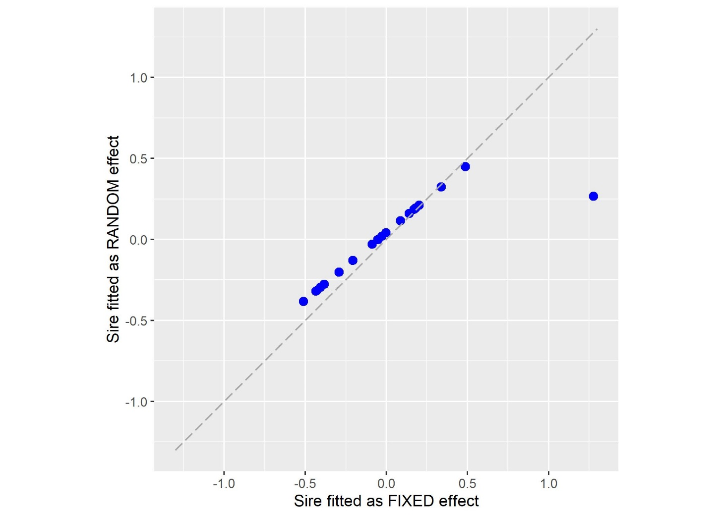
Applied to Each Effect …
19 sires, 20 offspring & 1 sire with 1
Less information
more shrinkage
to population mean

Slide 32
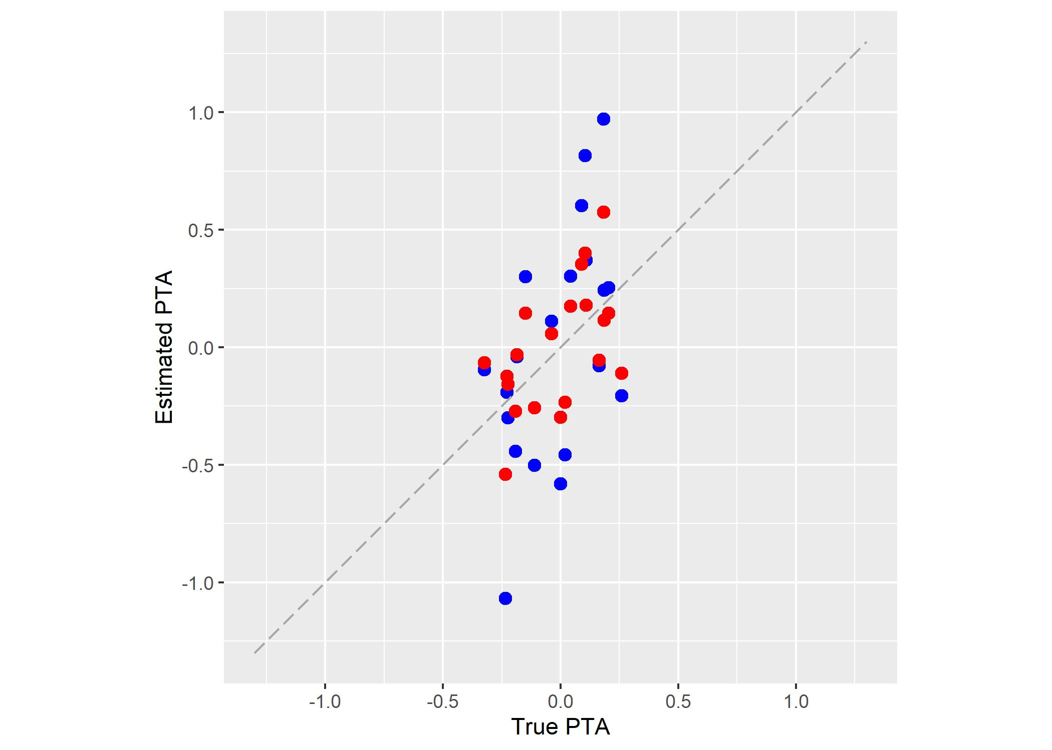
Benefits
Comparison of prediction errors
Sires fitted as RANDOM
Sires fitted as FIXED
Smaller prediction errors!

Slide 33
Summary
Random instead of fixed leads to shrinkage
regression back to the distribution mean …
regression coefficient, b ~ f(info)/[1+f(info)] < 1

Slide 34
Summary
Random instead of fixed leads to shrinkage
regression back to the distribution mean …
regression coefficient, b ~ f(info)/[1+f(info)] < 1
more info, f(info) increases and b → 1
the estimate has smaller random error
b → 1 with more data points
b → 1 with greater ‘signal to noise ratio’ per data point

Slide 35
Summary
Random instead of fixed leads to shrinkage
regression back to the distribution mean …
regression coefficient, b ~ f(info)/[1+f(info)] < 1
more info, f(info) increases and b → 1
the estimate has smaller random error
b → 1 with more data points
b → 1 with greater ‘signal to noise ratio’ per data point
shrinkage is differentially applied effect by effect
… i.e. sire by sire, or patient by patient, or tree by tree

Slide 36
Summary
Random instead of fixed leads to shrinkage
regression back to the distribution mean …
regression coefficient, b ~ f(info)/[1+f(info)] < 1
more info, f(info) increases and b → 1
the estimate has smaller random error
b → 1 with more data points
b → 1 with greater ‘signal to noise ratio’ per data point
shrinkage is differentially applied effect by effect
see ‘revision_5_heuristic.pdf’
see ‘revision_5_heuristic_Amatrix.pdf’

Slide 38
… Lecture 5 … Shrinkage
Part 2: the origins of REML

Slide 39
Model Terms
Models will have different types of terms
factors of interest e.g. genetics
concerned with objecctives and hypotheses being tested
fixed effect contrasts of breeds
random effect estimates of genetic variance or BV
nuisance factors
would not be present in an ideal experiment
e.g. ‘blocks’, fields, hospitals, herds, tanks, batches, quadrats

Slide 40
Model Terms
Models will have different types of terms
factors of interest e.g. genetics
concerned with hypotheses being tested
fixed effect contrasts of breeds
random effect estimates of genetic variance or BV
nuisance factors
would not be present in an ideal experiment
e.g. ‘blocks’, fields, hospitals, herds, tanks, batches, quadrats
a genetic model is only as good as its associated environmental model!

Slide 41
Fixed or Random
Choice of fixed/random depends on context
not automatic although often ‘routine’

Slide 42
Recovery of Inter-block Information
Patterson & Thompson’s original REML paper was on recovery of inter-block information
illustrates consequences of random/fixed choice
incomplete block designs e.g. fish tanks
e.g.
Tank 2
Tank 1
Tank 3

Slide 43
Recovery of Inter-block Information
If I assume there is no difference among the tanks
i.e. if variation among tanks is small
… I have a good experiment!

Slide 44
Recovery of Inter-block Information
If I assume the tanks are fixed
assume differences across tanks caused by unassessed, systematic effects outside of model
information on treatments must be assessed within tank … and then pooled
Tank 2
Tank 1
Tank 3

Slide 45
Recovery of Inter-block Information
If I assume the tanks are fixed
assume differences across tanks caused by unassessed, systematic effects outside of model
information on treatments must be assessed within tank … and then pooled
Tank 2
Tank 1
Tank 3
And the individual tanks are not well designed!

Slide 46
Recovery of Inter-block Information
If I assume the tanks are random
assume differences are caused by unknown random influences which have a variance
estimate degree to which tank differences are due to treatment and to the random tank variance
Tank 2
Tank 1
Tank 3

Slide 48
Phosphorus Metabolism
3 treatments in 3 blocks … poor !!!
A
B
C
B
A
C
A
B
C
B
A
C
I
II
III

Slide 49
Phosphorus Metabolism
3 treatments in 3 blocks … poor !!!
If blocks are fixed
only A & B can be compared
A
B
C
B
A
C
A
B
C
B
A
C
I
II
III

Slide 50
Phosphorus Metabolism
3 treatments in 3 blocks … poor !!!
If blocks are fixed
only A & B can be compared
If blocks are random
information on block differences from I & II allow an estimate of the variance between blocks
allows a partition of errors into block variance and residual variance
hence an estimate of treatment C!
value of estimate in this example?
A
B
C
B
A
C
A
B
C
B
A
C
I
II
III

Slide 51
Recovery of Inter-block Information
Patterson & Thompson’s original REML paper was on recovery of inter-block information
illustrates consequences of random/fixed choice

Slide 52
Recovery of Inter-block Information
Patterson & Thompson’s original REML paper was on recovery of inter-block information
illustrates consequences of random/fixed choice
Do you want to recover it?
the P study
confounding of treatment with block
Yes!!! It allows more estimates to be made

Slide 54
Genetic Variation in TB
A bovine TB breakdown is a mini-epidemic
Herds are closed during epidemic (H1, H2 …)
How does one interpret the following?
Herd 1: ††††
Herd 2: †
Herd 3
Sire families:
‘red’, ‘yellow’ & ‘blue’

Slide 55
Genetic Variation in TB
A bovine TB breakdown is a mini-epidemic
Herds are closed during epidemic (H1, H2 …)
How does one interpret the following?
Are herds fixed or random?
Herd 1: ††††
Herd 2: †
Herd 3
Is the mortality in Herd 1 due to the herd environment or the ‘red’ sire?

Slide 56
Genetic Variation in TB
Are herds fixed or random?
is it OK to say
“H1 high TB & ”, “H3 with low TB & ”, is evidence “ > ”?
i.e. is it OK to recover information from between herds?
i.e. is it OK to treat herds as random from a distribution?

Slide 57
Genetic Variation in TB
Are herds fixed or random?
why has Herd 3 no cases?
is it due to ‘blue’ sire or absence of pathogen?
no badgers?
“forces of infection”, importation events

Slide 58
Herds as Fixed
H1
H2
H3
H4
‘LS’ Means

Slide 59
Herds as Random
Regress back from ‘fixed’
H1
H2
H3
H4
Mean

Slide 60
Herds as Random
Released variation …
… re-interpreted by model
How! What model?
H1
H2
H3
H4
Mean

Slide 61
Genetic Variation in TB
Are herds fixed or random?
why has Herd 3 no cases?
is it due to ‘blue’ sire or absence of pathogen?
no badgers?
“forces of infection”, importation events
other systematic effects in a complex control system
Need an excellent between herd model!
otherwise you may interpret unknowns as genetics

Slide 63
Recovery of Inter-block Information
Patterson & Thompson’s original REML paper was on recovery of inter-block information
illustrates consequences of random/fixed choice
Do you want to recover it?
the P study
confounding of a treatment with block
the TB study
allowing information from one block to influence another and increase power

Slide 64
Recovery of Inter-block Information
Patterson & Thompson’s original REML paper was on recovery of inter-block information
illustrates consequences of random/fixed choice
Do you want to recover it?
the P study
confounding of a treatment with block
the TB study
allowing information from one block to influence another and increase power
Yes!!! It allows more estimates to be made

Slide 65
Recovery of Inter-block Information
Patterson & Thompson’s original REML paper was on recovery of inter-block information
illustrates consequences of random/fixed choice
Do you want to recover it?
the P study
confounding of a treatment with block
the TB study
allowing information from one block to influence another
Yes!!! It allows more estimates to be made
No! The assumptions make the findings more vulnerable to model error.

Slide 67
… Lecture 5 … Shrinkage
Part 3: some generalities

Slide 68
Genetic Models
Often genetic effects treated as random
Sire models
assume sire effects are σ_{s}² I with σ_{s}² = ¼ σ_{A}²
σ_{A}² is the additive genetic variance
or σ_{s}² A (as Tutorial 1!)
A is Numerator Relationship Matrix
Individual Animal model
assume genetic effects of individuals are σ_{A}² A
or with genomic data σ_{G}² G

Slide 69
Genetic Models
‘Genetics’ is not always random
may sometimes be fixed
e.g. breed is typically fixed
next lecture

Slide 70
Environmental Models
Spatial models, e.g. pens in a shed
or desks in a classroom
or plots/quadrats in a field or forest
or tanks in aquaculture shed

Slide 71
Environmental Models
fixed = … + pen
here 23 d.f.

Slide 72
Environmental Models
fixed = … + row + column, random = … + pen
here 8 d.f. (3 for row, 5 for column) & V_{pen}

Slide 73
Environmental Models
fixed = … + x_{light} + x_{temp}, random = … + pen
here 2 d.f. & V_{pen}
Light
Temperature

Slide 74
Genetic Models
‘Genetics’ is not always random
may sometimes be fixed
e.g. breed is typically fixed
next lecture
e.g. offspring of 10 ‘top’ sires and 10 ‘bottom’ sires taken from a distribution of 100
perhaps no data available on how selection was made
fixed effect GG (genetic group, 1 d.f.), high or low sire
fixed = …+ GG +… , random= …+vm(id,ainv)+…

Slide 75
Conclusion
An effect can be described by a combination of fixed and random components!

Slide 76
Fixed & Random Interactions
 | Factor 1
Factor 2 | Fixed | Random
Fixed | Either | Random
Random | Random | Random
Two-way
if one factor random, interactions must be random
if factors are fixed then choice
Multi-way
if any lower order interaction is random, then high order is random

Slide 77
Summary
Choice of fixed or random influences how information is used
fixed or random is not absolute
using a factor as random is making an assumption about the nature of the effect
depends on the modelling consequences of making the assumption
A genetic model is only as good as its environmental model!

